Slide 1
Image formation

Slide 2
Image Formation
Vision infers world properties form images.
How do images depend on these properties?
Two key elements
  Geometry
  Radiometry
  We consider only simple models of these

Slide 3
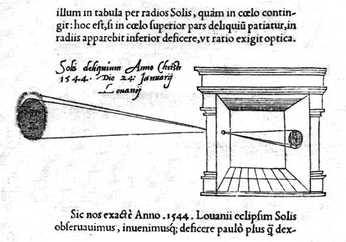
Camera Obscura
"When images of illuminated objects ... penetrate through a small hole into a very dark room ... you will see [on the opposite wall] these objects in their proper form and color, reduced in size ... in a reversed position, owing to the intersection of the rays".
Da Vinci
http://www.acmi.net.au/AIC/CAMERA_OBSCURA.html (Russell Naughton)

Slide 4
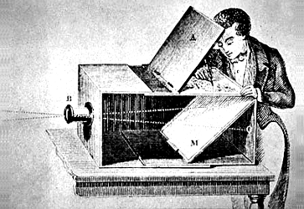
Used to observe eclipses (eg., Bacon, 1214-1294)
By artists (eg., Vermeer).

Slide 5
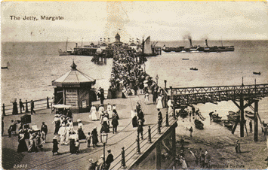
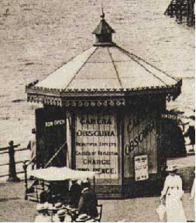
Jetty at Margate England, 1898.
http://brightbytes.com/cosite/collection2.html (Jack and Beverly Wilgus)

Slide 6
Cameras
First photograph due to Niepce
First on record shown in the book - 1822

Slide 7
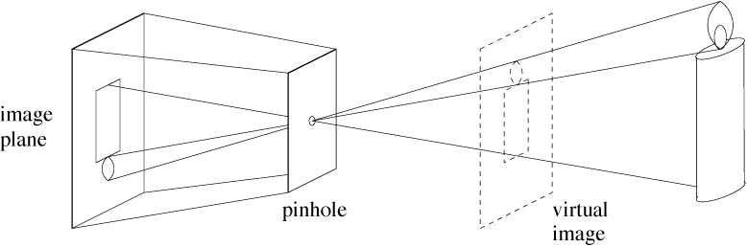
Pinhole cameras
Abstract camera model - box with a small hole in it
Pinhole cameras work in practice
(Forsyth & Ponce)

Slide 8
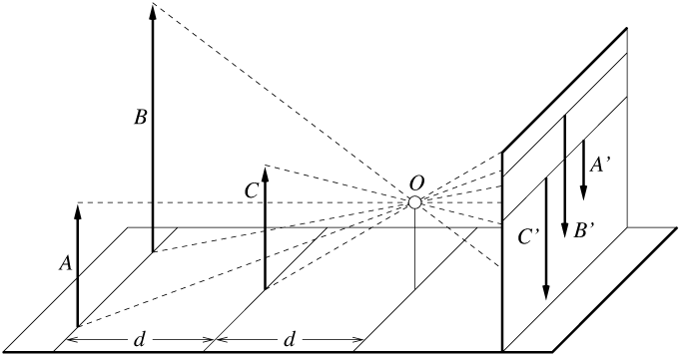
Distant objects are smaller
(Forsyth & Ponce)

Slide 9
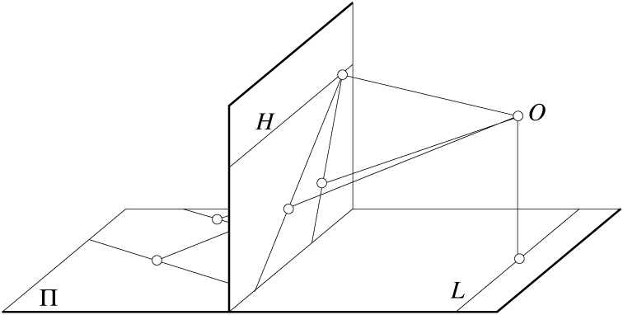
Parallel lines meet
Common to draw image plane in front of the focal point. Moving the image plane merely scales the image.
(Forsyth & Ponce)

Slide 10
Vanishing points
Each set of parallel lines meets at a different point
  The vanishing point for this direction
Sets of parallel lines on the same plane lead to collinear vanishing points.
  The line is called the horizon for that plane

Slide 11
Properties of Projection
Points project to points
Lines project to lines
Planes project to the whole image or a half image
Angles are not preserved
Degenerate cases
  Line through focal point projects to a point.
  Plane through focal point projects to line
  Plane perpendicular to image plane projects to part of the image (with horizon).

Slide 12
Take out paper and pencil

Slide 13
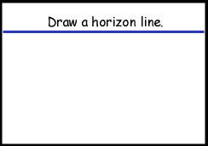
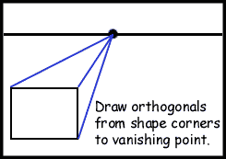
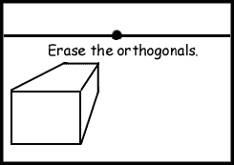
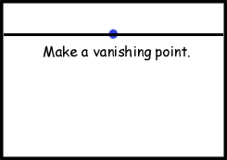
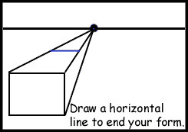
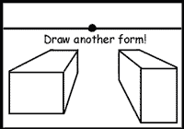
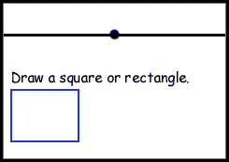
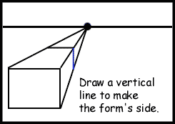
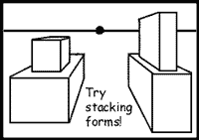
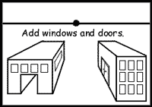

Slide 14
http://www.sanford-artedventures.com/create/tech_1pt_perspective.html

Slide 15
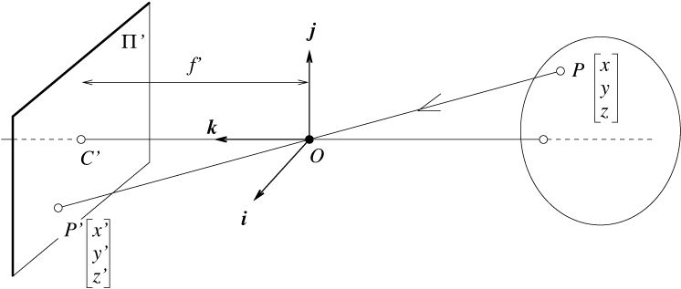
The equation of projection
(Forsyth & Ponce)

Slide 16
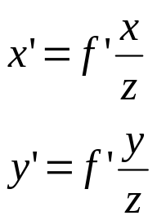
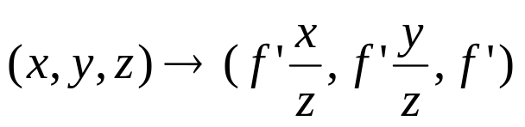
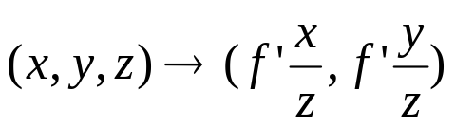
The equation of projection
Cartesian coordinates:
  We have, by similar triangles, that
  Ignore the third coordinate, and get

Slide 17
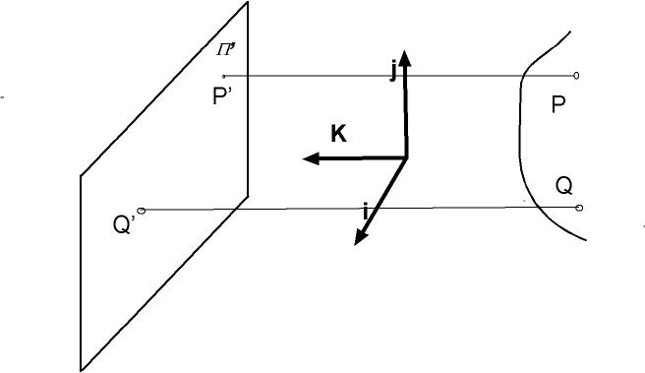
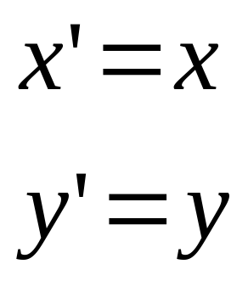
Orthographic projection

Slide 18
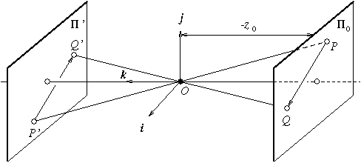
Weak perspective (scaled orthographic projection)
Issue
  perspective effects, but not over the scale of individual objects
  collect points into a group at about the same depth, then divide each point by the depth of its group
(Forsyth & Ponce)

Slide 19
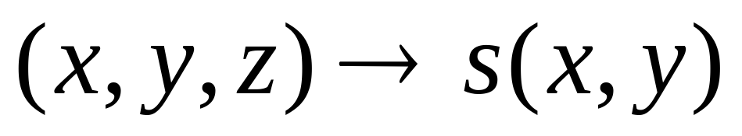
The Equation of Weak Perspective
s is constant for all points.
Parallel lines no longer converge, they remain parallel.

Slide 20
Pros and Cons of These Models
Weak perspective much simpler math.
  Accurate when object is small and distant.
  Most useful for recognition.
Pinhole perspective much more accurate for scenes.
  Used in structure from motion.
When accuracy really matters, must model real cameras.

Slide 21
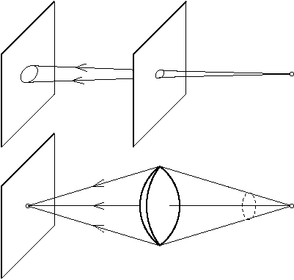
Cameras with Lenses
(Forsyth & Ponce)

Slide 22
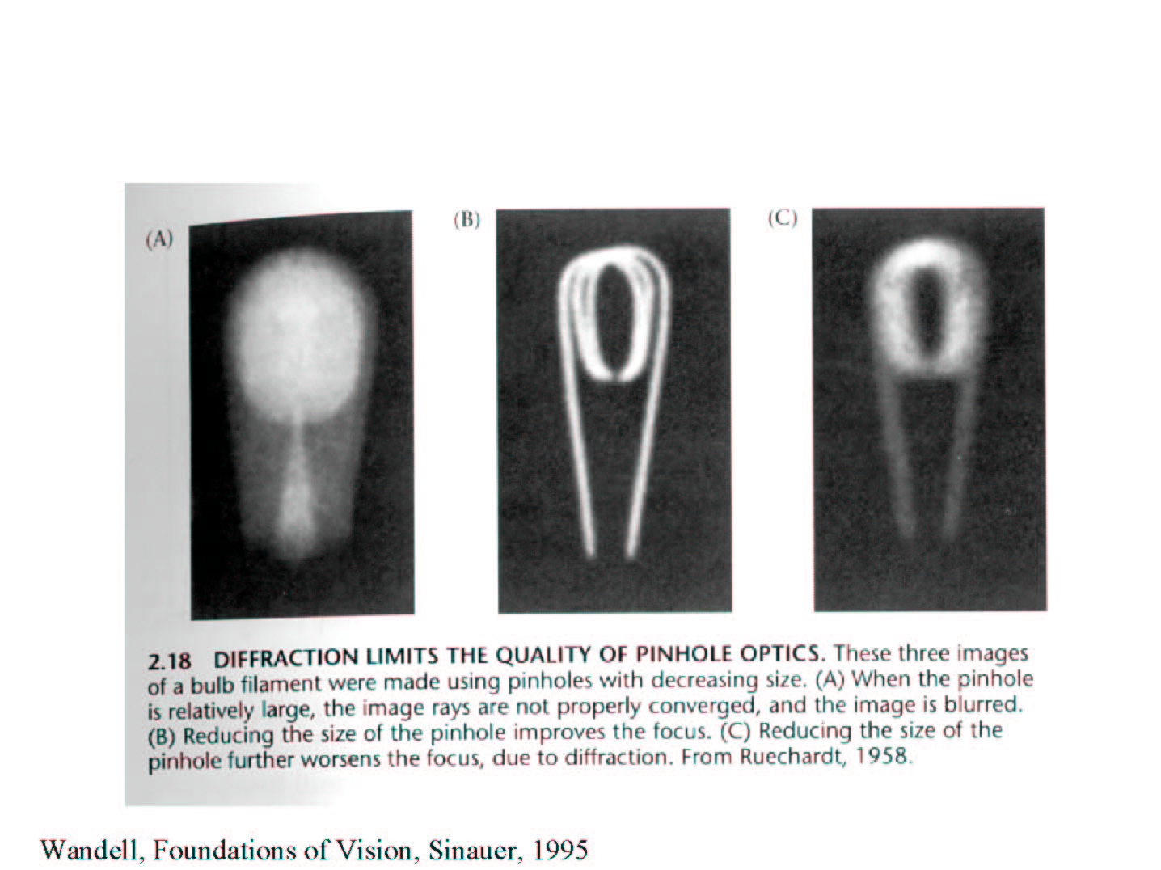

Slide 23
Interaction of light with matter
Absorption
Scattering
Refraction
Reflection
Other effects:
  Diffraction: deviation of straight propagation in the presence of obstacles
  Fluorescence:absorbtion of light of a given wavelength by a fluorescent molecule causes reemission at another wavelength

Slide 24
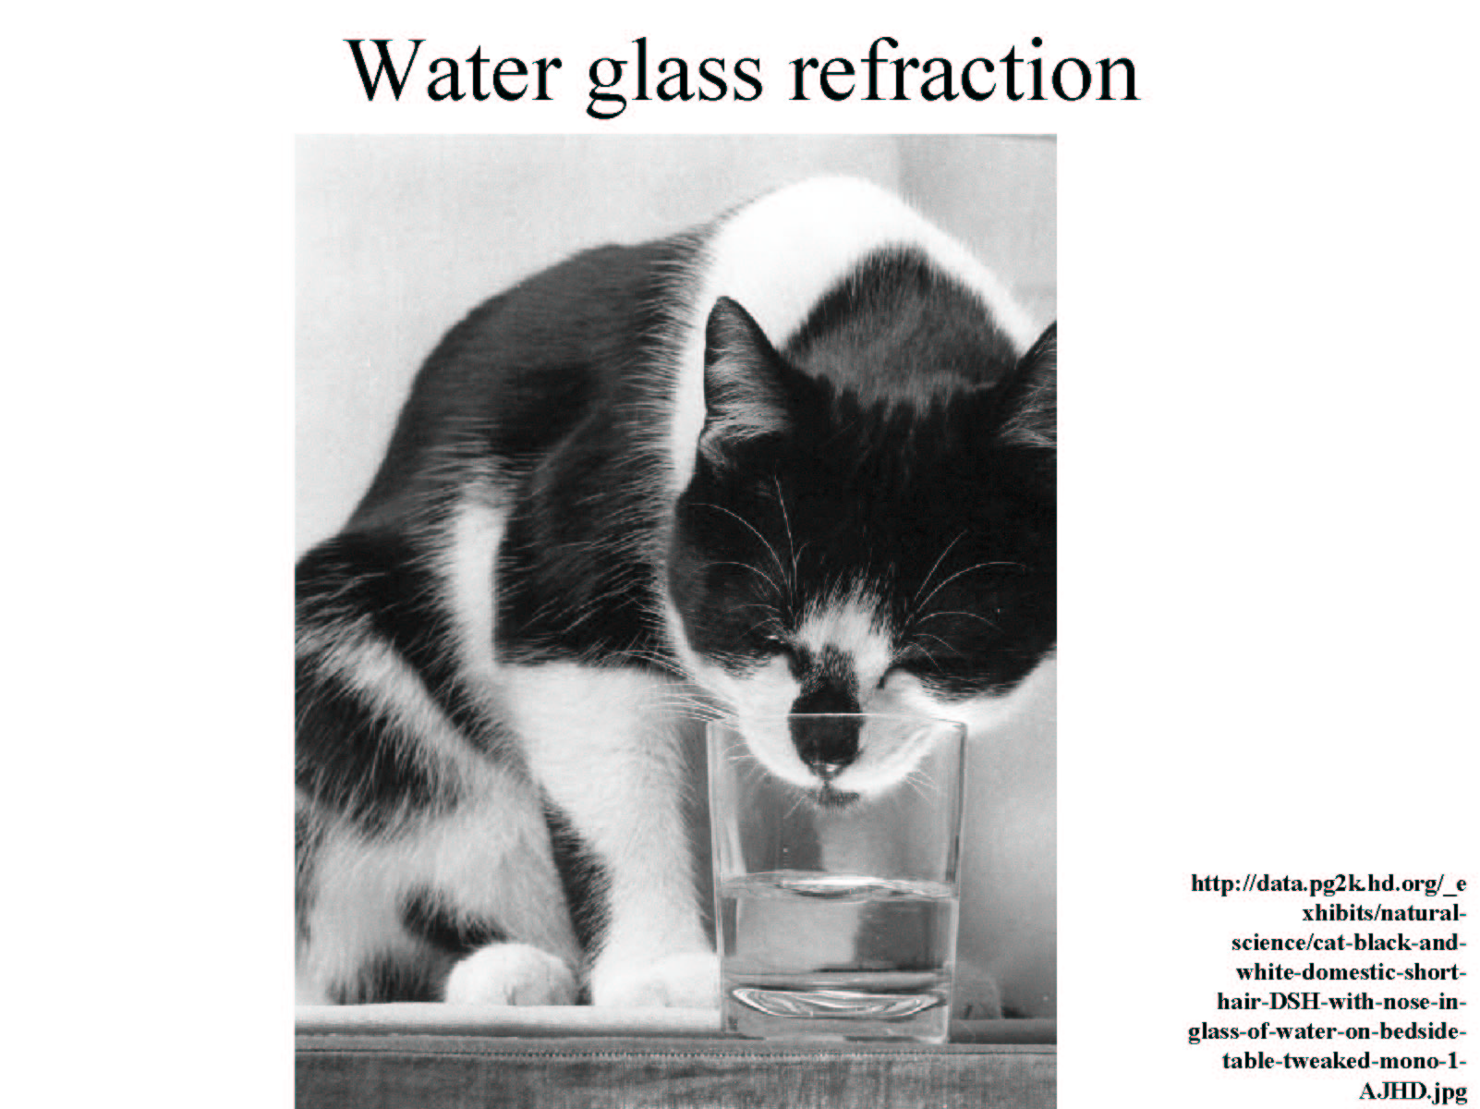

Slide 25
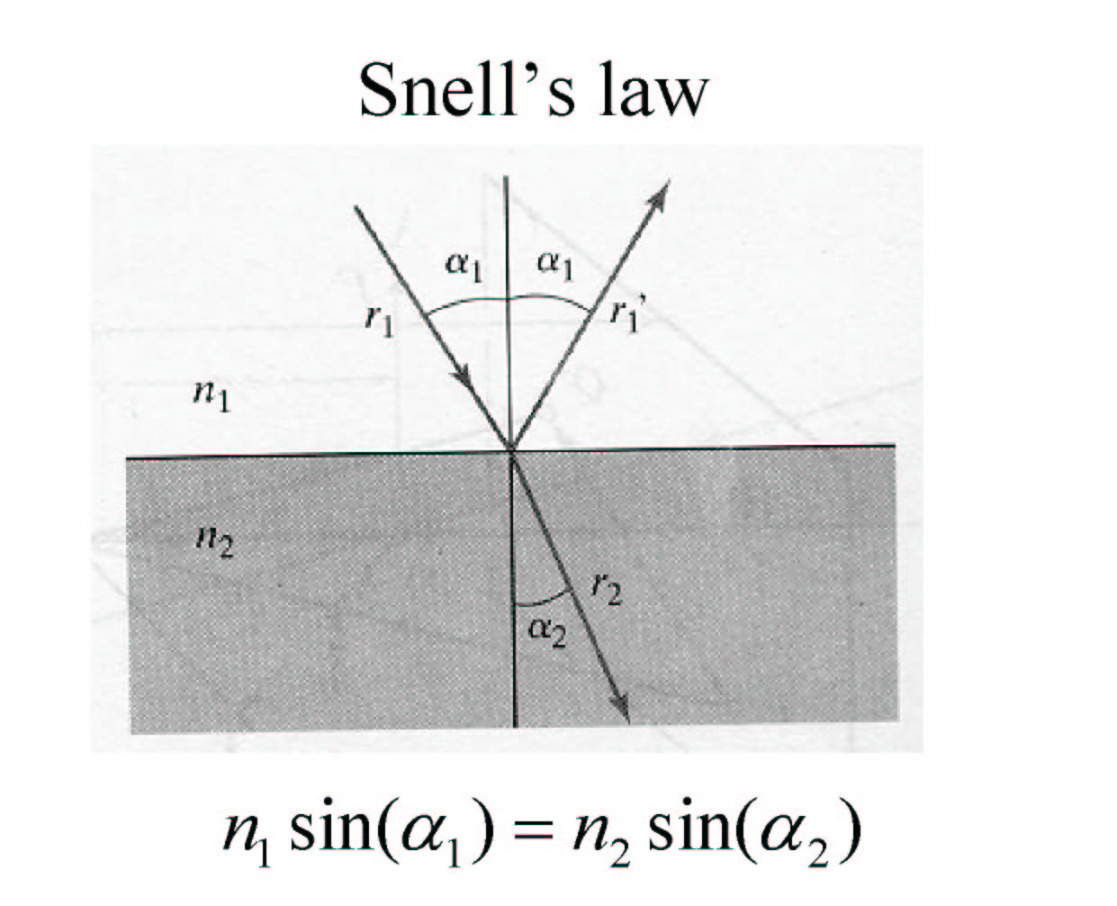
Refraction
n1, n2: indexes of refraction

Slide 26
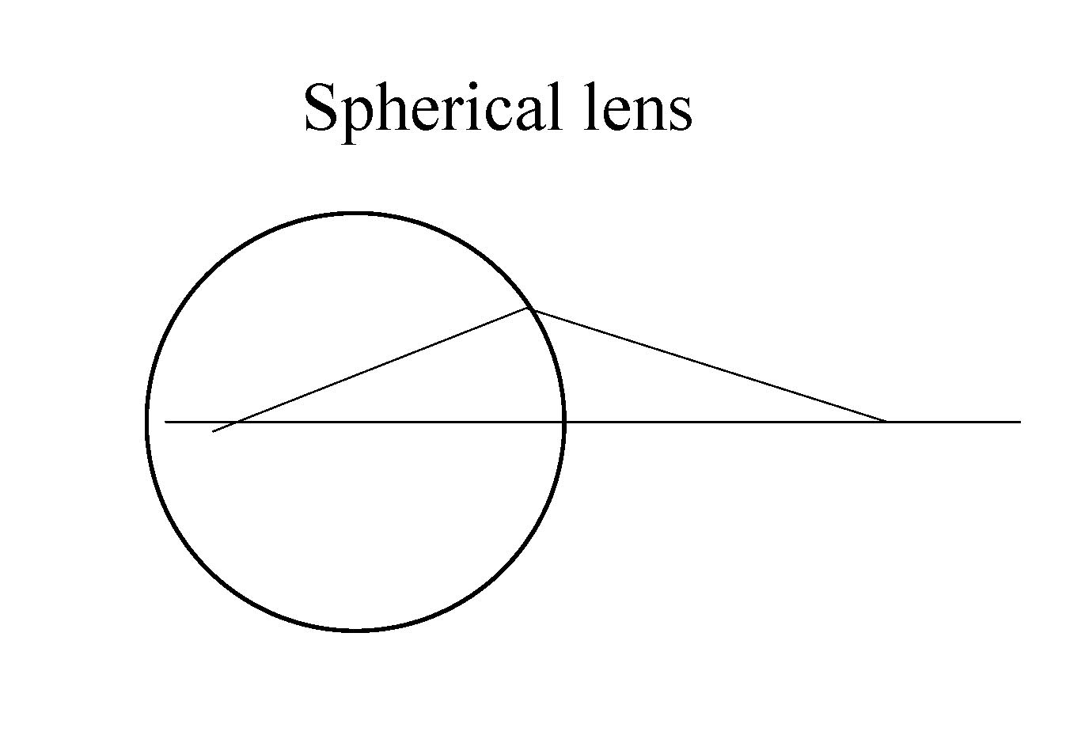

Slide 27
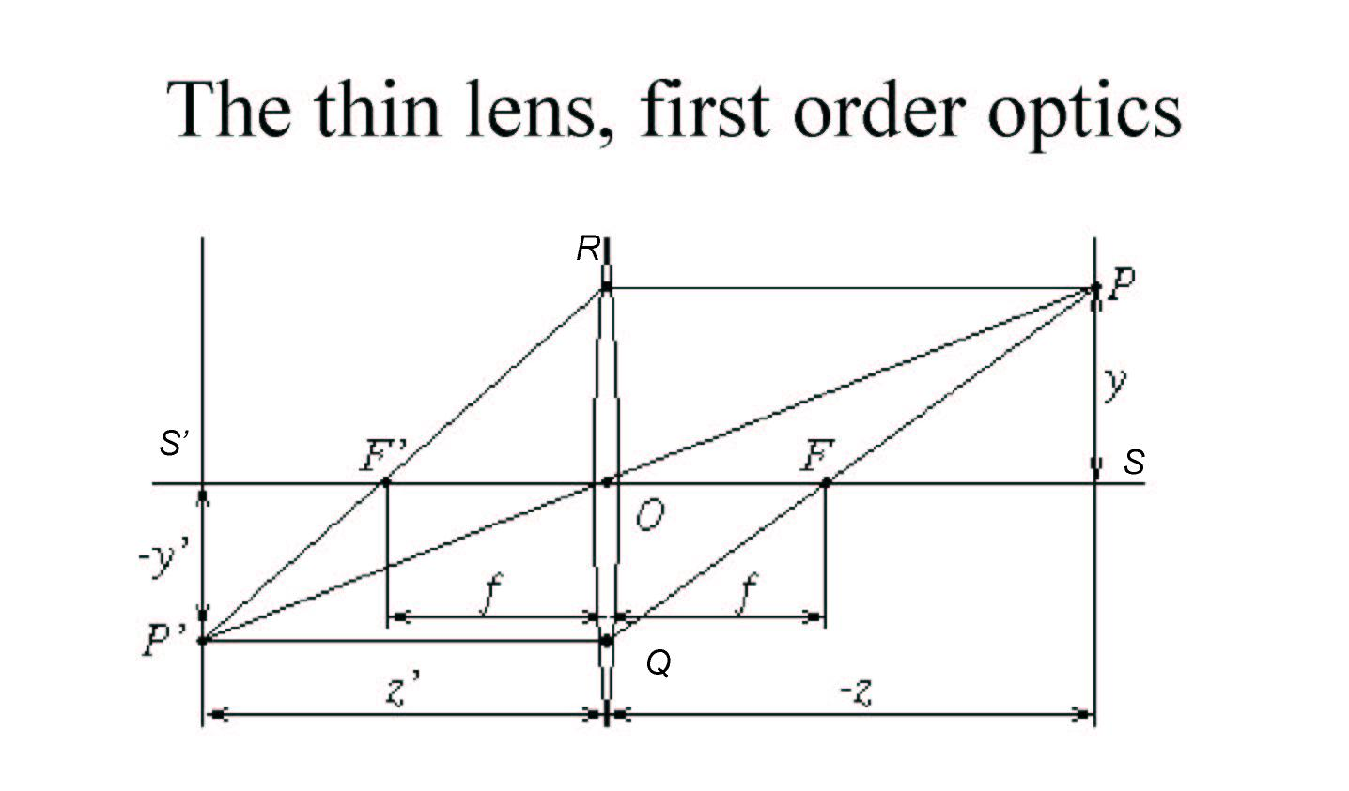

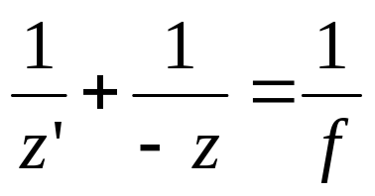
Similar triangles <P’F’S’>,<ROF’> and <PSF><QOF> →

Slide 28
Assumptions for thin lens equation
Lens surfaces are spherical
Incoming light rays make a small angle with the optical axis
The lens thickness is small compared to the radii of curvature
The refractive index is the same for the media on both sides of the lens

Slide 29
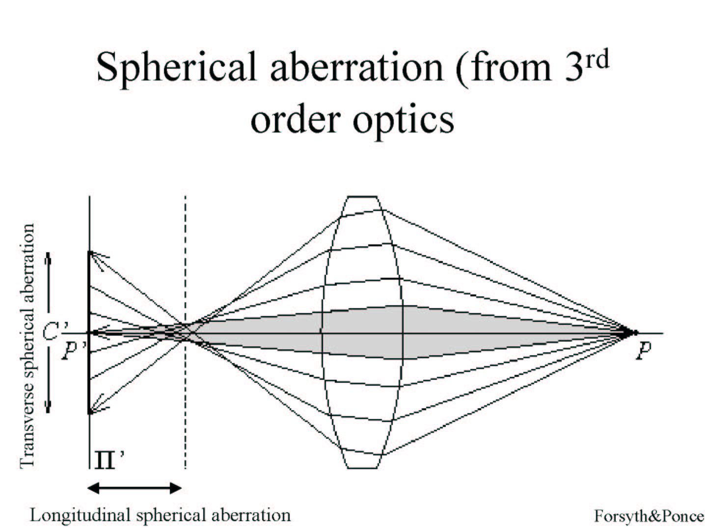

Slide 30
Other aberrations
Astigmatism: unevenness of the cornea
Distortion : different areas of lens have different focal length
Coma : point not on optical axis is depicted as asymmetrical comet-shaped blob
Chromatic aberration

